Slide 1
Notes:
Leave this up until we are ready to go….

Slide 2
Celebration of New Designees
Dallas CPCU Chapter – August 27, 2019
Notes:
Thank you for having me attend today. It is both an honor and privilege to celebrate with you all today!
Before we complete the conferment today, I’d like to take a few minutes to share some what we are up to at the Society:
CPCU Society At-A-Glance
With 125 vibrant chapters and enhancing our 14 very special interest groups, we are a global community of close to 20,000 risk professionals, either holding or working towards a CPCU, the industry’s premier designation and recognized marker of the highest professional and ethical standards.
The Value of Membership
In a rapidly changing industry, we help our members stay current, step up and deliver results for their clients and companies
We help go-getters continue to deepen their expertise and prepare to take on new challenges
Volunteer opportunities hone new skills – members can experience hands-on leadership development through our local chapters, Committees, Task Forces, and more
Our members are thought leaders and we encourage them to give-back and showcase their knowledge by serving as authors, speakers, and webinar presenters.
Whether through a local chapter or by attending our Annual Meeting, members connect with leading industry professionals to build their networks and develop pathways to new business
Additional Benefits
Unlimited access to no-cost monthly webinars (cost to nonmembers $79 each)
Discounts on Institutes study material, CEU.com online courses, and Annual Meeting registration
Waiver of the $189 CE for CPCUs reporting fee
Access to our online Knowledge Center featuring over 180 content resources
Subscription to Insights, our quarterly professional journal

Slide 3
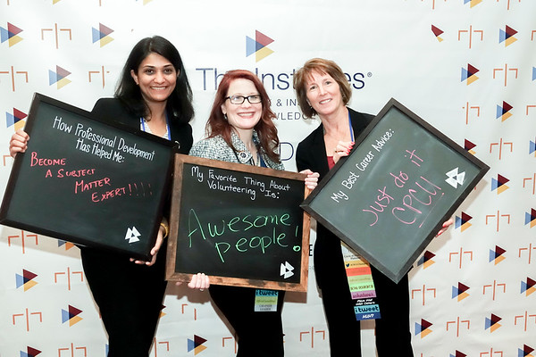
Celebrating 75 years!!
Lead More. Do More. Be More.
Notes:
Lead more – HAPPY 75th Anniversary!!
It’s not every day we get to celebrate an accomplishment as extraordinary as 75 years of elevating our industry.
75th Logo: you’ll know we have something to share on the 75th when you see the logo!
Member Spotlights: we’ll be highlighting 75 dedicated members and their contributions throughout the year.
Throwback Thursday: Follow #CPCU75 on our social platforms for a new #TBT each week.
Monthly Emails: Every month, members will receive a 75th themed email so you can learn more about how far we’ve come.
Memory Microsite: Share your own memories, stories, and photos– we have BIG plans in store for the content we collect. Make sure you’re a part of it.
Video Clips: look for videos throughout 2019 to see our rich history over the years.
75th anniversary pins: Don’t miss your chance to get a commemorative pin! We will have these available for our volunteer leaders at this year’s Leadership Summit and Regional Meetings.
I also have pins for the New Designees today too ☺
2019 Annual Meeting celebrations: Make this our best conference yet! We want to see all our members in New Orleans as we toast to our anniversary and celebrate 75 years of accomplishment and success.
Insights Special Features: Expect to see glimpses of our publication history in your 2019 issues culminating in a special celebratory Collector’s Edition in the winter.
Volunteer Toolkit: Look forward to receiving a 75th anniversary toolkit with even more tips on what you can do to celebrate at your local chapters, events, and more.

Slide 4
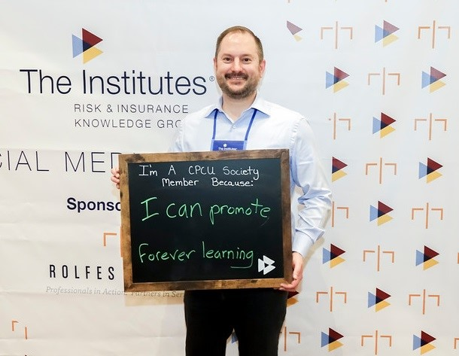
POWER OF ONE
Notes:
And how can we sustain and grow our membership. One person at a time. My theme for my Presidency this year has been the POWER OF ONE…..
I firmly believe that one person can make a difference. What if each of our members asked just one person to attend a CPCU event with them? Imagine the collective impact that would be?! What will your contribution be?
Think of your colleagues, coworkers, and team members – who are your go-getters? Those motivated, enthusiastic individuals always searching for that next challenge. The ones we quite simply just “see something” in. Identify that person and ask them to get involved. I have no doubt we each remember that special someone who first saw something in us, that person who helped us realize our true potential. I’m asking you to pay that forward. A single, personal ask cannot be underestimated – it is more powerful than you can ever imagine.
As you plan to engage your go-getters, consistent and frequent communication will be key and I’m so excited to share with you the 2019 CPCU Society Messaging Toolkit. I believe that with consistent messaging combined with our personal success stories, we can make more of an impact than ever before.
But it doesn’t stop there. We need to know what’s working, what you need, and especially your success stories. Email Jessie Gaudio, Senior Director of Membership, to share any feedback you have.

Slide 5
CPCU offers…
Education
Ethics
Experiences
LOTS OF STUDYING….
Notes:
How we all got here today….opportunity to grow in our industry, be part of an elite group of professionals – only 2% of our industry actually attain the CPCU Designation.
Education CPCUs pass eight national exams on topics including insurance law, accounting, risk management, and ethics. CPCUs continually update their base of insurance expertise by participating in technical and professional development workshops and seminars.
Ethics CPCUs promise to abide by a Code of Professional Ethics, placing their clients’ needs before their own.
Experiences CPCUs meet an experience requirement to become a CPCU and have proven insurance expertise and knowledge.
And oh gosh, all that studying….

Slide 6
CPCU, our Future is BRIGHT!
Strategies to get us there:
CPCU will be known as the premier community of risk and insurance thought leaders
Industry leaders recognize the CPCU Society as inclusive, with a specific identity and a wise investment for their employees
A more diverse membership increase, increase conversion of new designees
The CPCU Society is recognized as a leader in social responsibility
Notes:
I like to take a few minutes and share where the CPCU Society is headed.
Last November, I pulled LC team together and we focused on our future as an organization.
What were our must haves, changes we needed to make to evolve with our industry, stop doing, start doing and revamp/enhance.
These are the 4 strategies. Everything we are working on, when I say we, the CPCU paid staff and the CPCU volunteers. Every project and decision must fall under one of these strategies. If it does not, it goes on the FUTURE WISH LIST.
So let’s walk through this briefly……What is the CPCU Society working on?
Here is what we are committed to help us all get there….where is there:
Strategy #1 – how do we want to get there:
Increase relevant, innovative educational opportunities that result in increased participation
Increase visibility through partnerships with other industry organizations
Increase communication of our value proposition through multiple channels
Revamped vision and mission statements
Develop strategies to engage the next generation and be their community
Revamp events to support goals
The Annual Meeting being renamed, change from the Annual Party to the GO-TO insurance symposium
The New Designee celebration on the last night, not the first full day, who wants to get up and attend meetings a night after the party?
#2 increase communications around the value of the CPCU membership
Increase awareness of the correlation between CPCUs and business results
We have been working on the restructure of our Interest Groups. The underlying goal is to enhance the value and relevance of the interest groups for the benefit of all society members.
Promotion membership thru enhanced visibility of the CPCU designation and the Society across the Risk Management industry
Local chapters are partnering with RIMS, local colleges, etc. Great ways to partner in our communities.
CPCU is considering partnerships in the future
#3 Increase membership
Strengthen the value proposition and provide relevant benefits
We have been membership decline, this is real along many organizations right now, we need to keep getting better at promoting our community as the WANNA BE THERE PLACE and Hang with really cool insurance people
#4 Explore how to involve and engage membership in a social responsibility initiative.
In San Diego Annual Meeting, we featured the ____________________ as our philanthropy for members. We will continue this in NOLA.

Slide 7
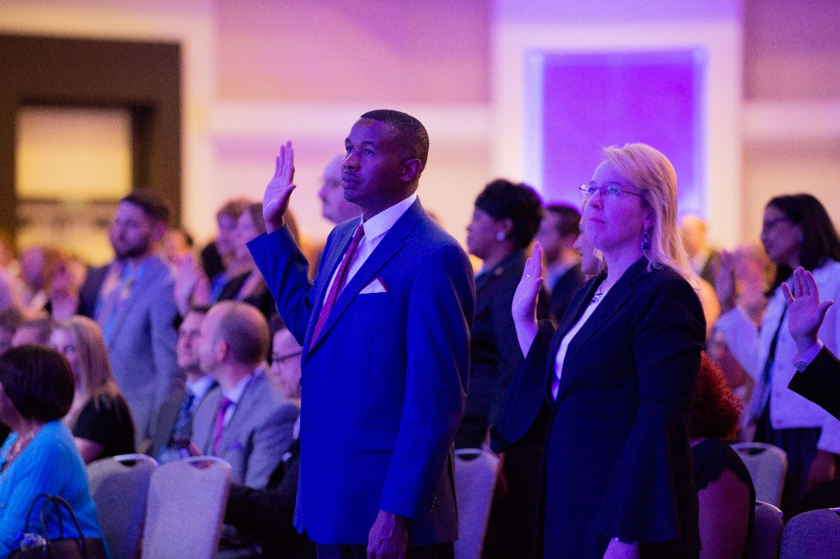
New Designee Conferment
Life long learning opportunity
Rights and Privileges
Active Member
Highest Ethical Standards
Notes:
So let’s get to the heart of our organization, our members. One of our strategies is to increase membership. Let’s now welcome our new designees into our premier CPCU Society with our ND conferment….
WILL CONDUCT THE NEW DESIGNEE conferment here…..
Be a life long learner – the spirit of this term is relevant in today’s every changing world. Continue learning throughout your working life. It will enable you to maintain the high level of technical competence expected from today’s professionals. It helps us stay relevant in times of ever changing work landscapes. And I would like to add, if you are interested in learning more about leadership what a better time that to be a leader in your local chapter – this translates into opportunities in your organization and in the insurance industry!!
Second, accept willingly the responsibilities of the CPCU designation that accompany rights and privileges.
Conduct yourself honorably and with dignity
Avoid practices what would bring dishonor or reproach on your profession and the CPCU designation
Refrain from whatever it, or might be commercialization of misuse of the designation.
Third, as I stated earlier, become an active member of the CPCU Society. Your association wit your peers in your professional society will give you a variety of opportunities for professional friendships, continued learning, public service, and personal growth. And finally in your business activities, faithfully adhere to the highest ethical standards.
Lastly, As a CPCU designee, you agreed to maintain the standards set by the American Institute’s Code of Professional Ethics. There standards will continue to guide you as you serve others.
My question is – Are you ready?

Slide 8
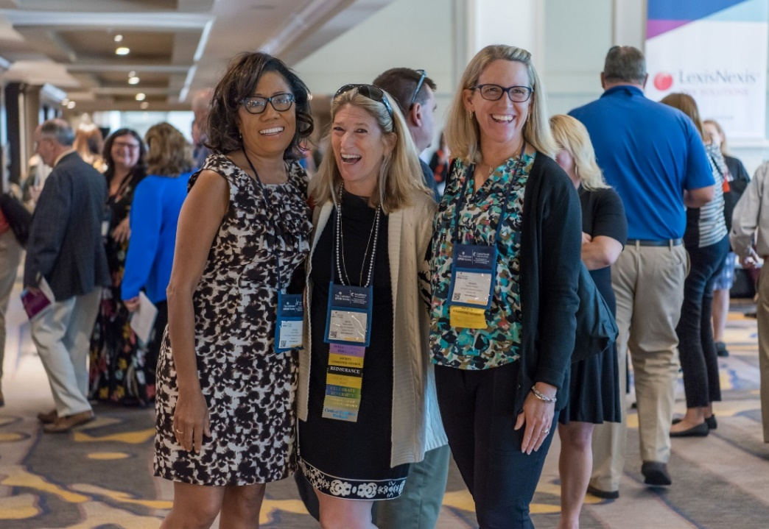
My challenge to all CPCUs…
Share your talents locally and globally
Grow and help build the CPCU Community
Make life long friends
Notes:
Opportunities are abundant
Your CPCU Society wants you to share your talents and skills with others. Whether that be in your local chapter, serving your community OR to the global stage learning and sharing your talents with our European insurance friends.
Get to know the CPCU members in your local chapter. Join a committee? What interests you? Serving others comes back 10 fold. If you are interested in leadership at your company, maybe this is a good time to test the waters? Volunteer leadership is free and we welcome the opportunity to see you grow.
In my CPCU journey, I have had the pleasure of meeting some of the most amazing people and growing my CPCU community has been a journey of cherished friendships and valued insurance partnerships.
I stand firm on the belief that the power is yours or mine alone. The Power of One! Because you along control what you put into the CPCU community and what you get out of your involvement with the CPCU Society!

Slide 9
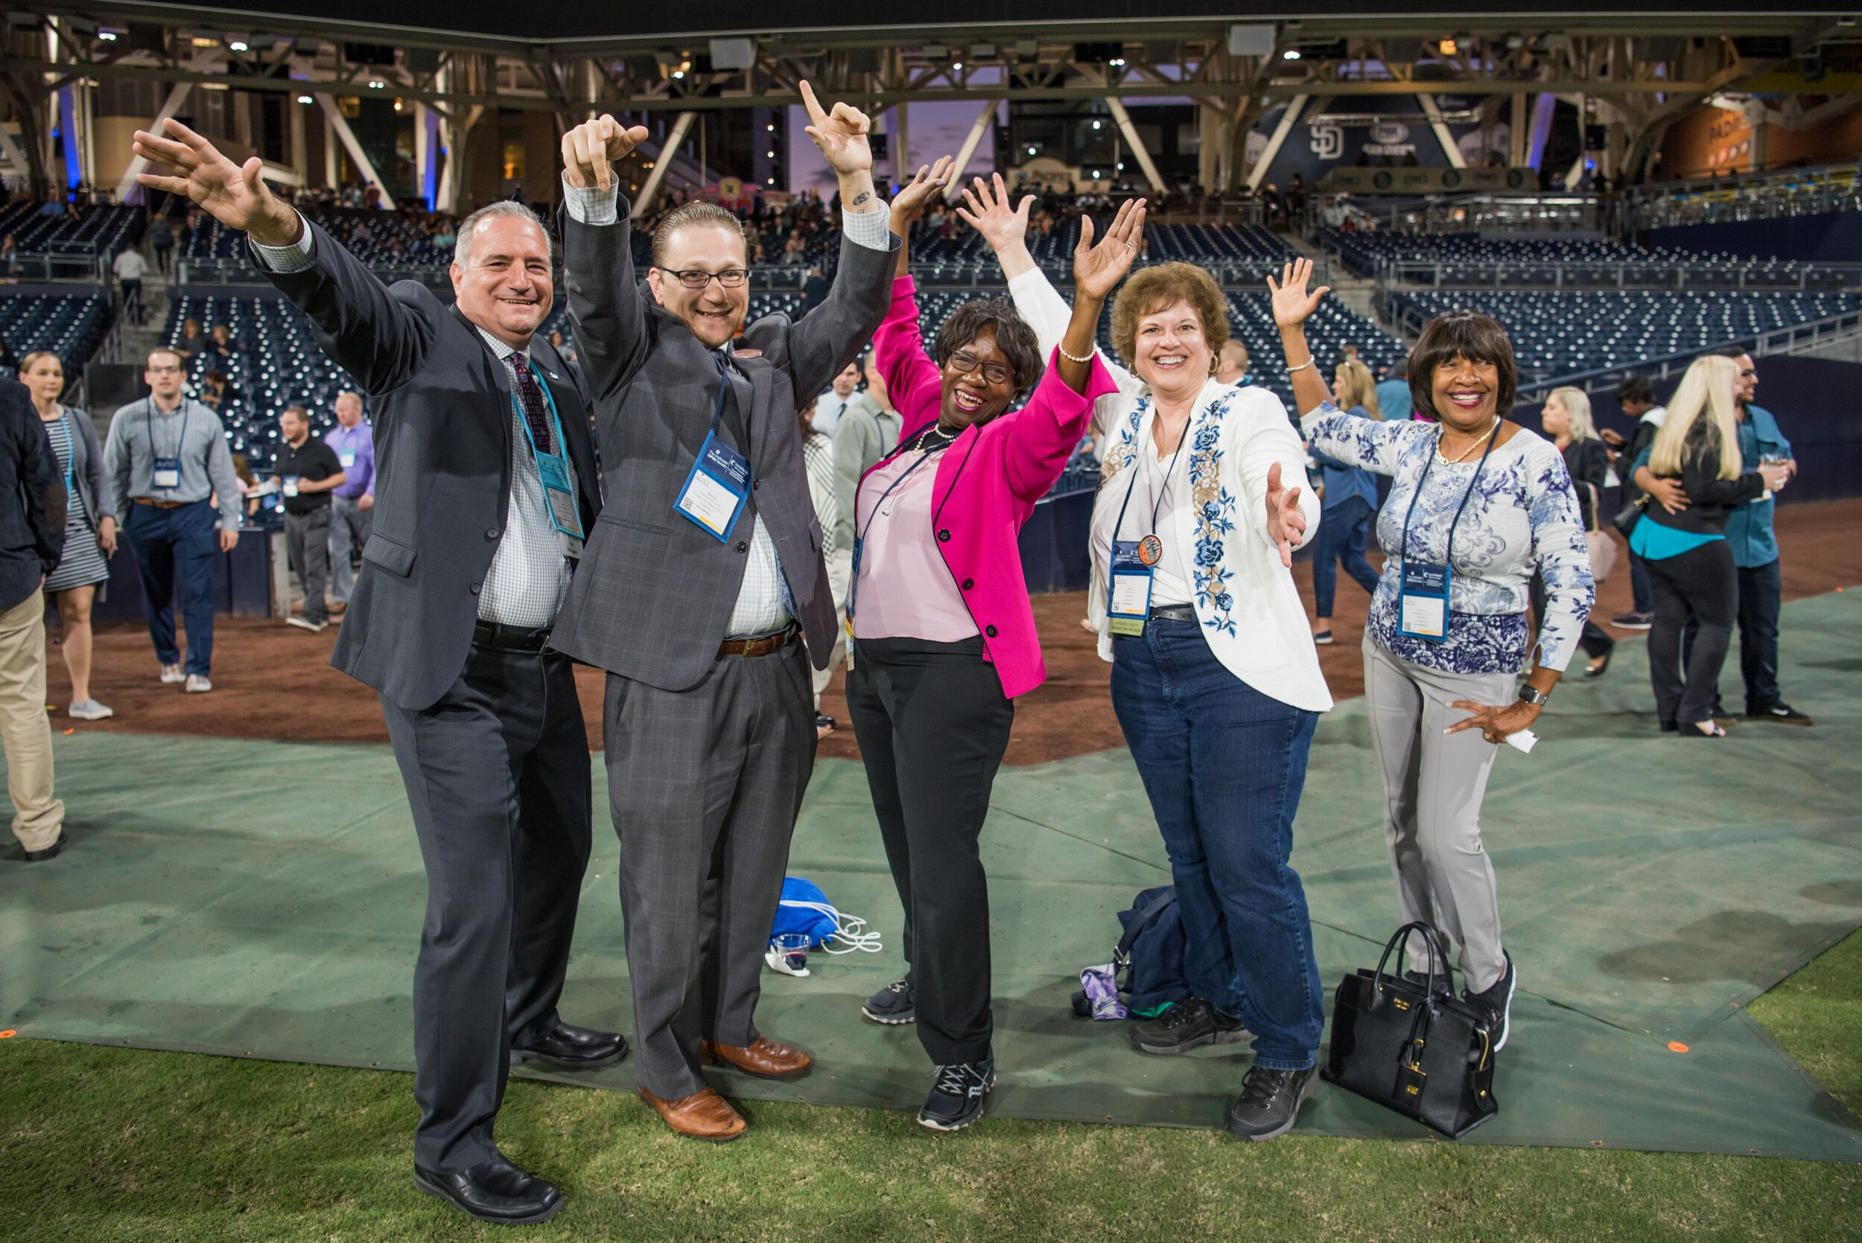
Congratulations New Designees!

